Slide 1

Analytics for Learning Impact
Capstone Project
Notes:
Photo divider page template, centre aligned
To change photo:
Delete existing one
Click on the central icon or drag and drop
Right click and send to back if photo is in front of text

Slide 2

Kineo 20th Anniversary

Slide 3








Kineo Analytics Framework
Organisation Analytics
(platform)
Are departments meeting compliance completion targets?
Where, when and how are learners most active and engaged?
How well do skills and competencies align with career pathways and where are the gaps?
Compliance (Completion) | Engagement (Experience) | Skills
Learning Analytics
(course)
What do they already know and where are the gaps?
Does your learning increase the confidence of your learners?
How long do learners take to complete learning?
Did learners enjoy the learning?
Competence (Applied Knowledge) | Perception (Confidence) | Engagement (Interaction) | Reaction

Slide 4
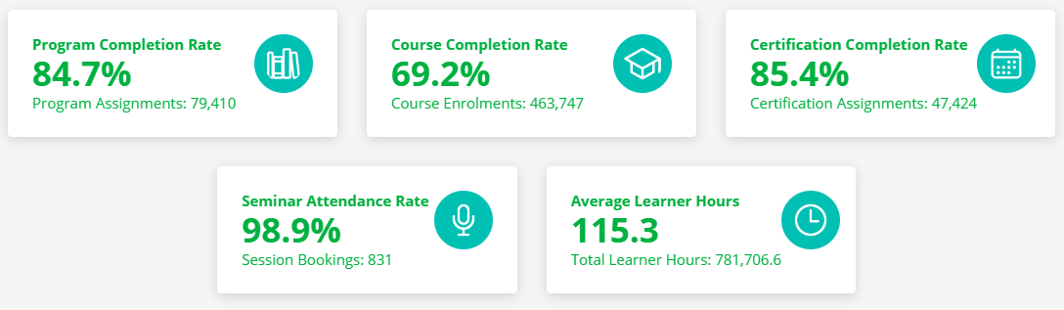

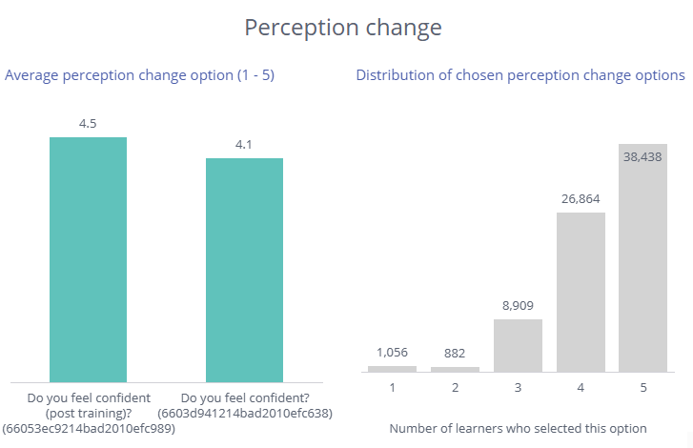
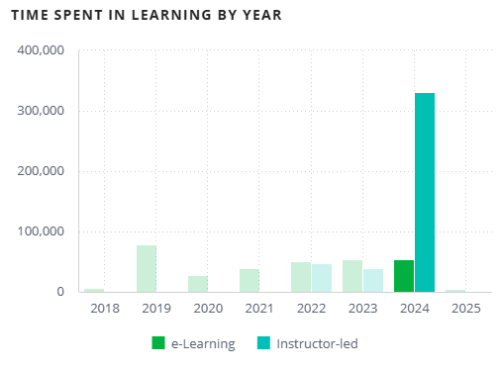

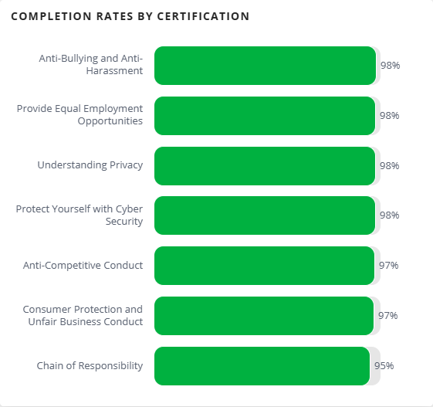
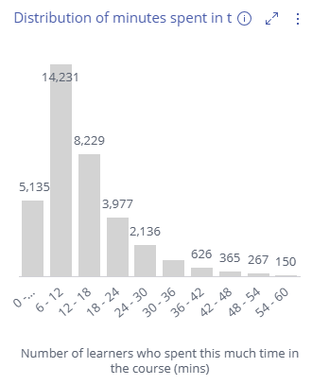

Kineo Analytics Launched in 2024
340 Learning Content datasets
Course completions
Time spent in learning
Perception change
Assessment distributions
22 Learning Platforms datasets
Course/program/certificate completions
Time spent in learning (ILT –vs- eLearning)
ILT attendance
4 Premium Services
Skills gap analysis
Segregated tenancies

Slide 5
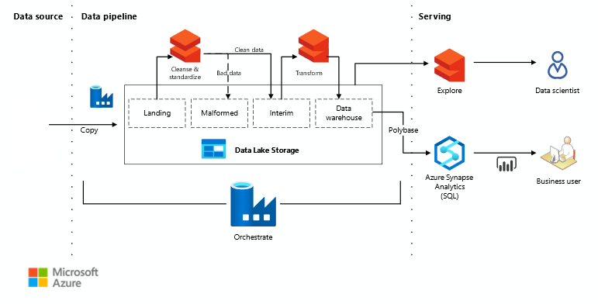
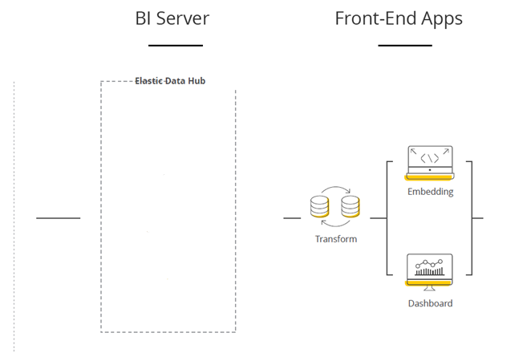
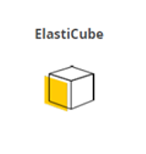









Our Project
Current technology
Desired technology: Modern data pipelines
Challenges:
Scalability and cost of Elasticubes
Ability to combine different data sources
Limited front-end options
Requirements:
Ability to collect data from different sources or systems
Infrastructure as code: deploy in an automated manner
Deploy application changes in an automated manner
Segregate data into three regions: AU, US, UK
Diverse front-end options including BI and AI tools

